Slide 1
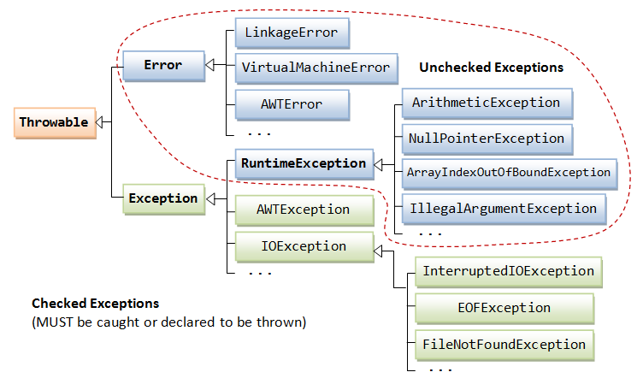
Types of Exception
Error is considered as unchecked exception.
Error is irrecoverable.
Unchecked exceptions are the class that extends RuntimeException.
Unchecked exceptions are checked at runtime.
The exception that can be predicted by the programmer. Example : File that need to be opened is not found.
These type of exceptions must be checked at compile time.

